Slide 1
KMOU Division of Marine System Engineering
Introduction to
Internal Combustion Engine

Slide 2
Lesson content for each week
Ch0_Introduction to the Class | Ch6_Piston Fittings and Crankshaft
Ch1_Overview of the Internal Combustion Engine | Ch7_Lube Oil System
Ch2_Thermodynamics and Compressed Air System | Ch8_Cooling Water System
Ch3_Marine Fuels and Internal Fuel Oil System | Ch9_Introduction to the Main Engine
Ch4_Intake and Exhaust System | Ch10_Alternative Fuels and Alternative Fuel Systems
Ch5_Turbocharger | Ch11_Environmental Regulations and Exhaust Gas Aftertreatment Systems
Midterm | Ch12_Tools, Apprentice Engineer Duties, and Career Direction
 | Final Exam

Slide 3
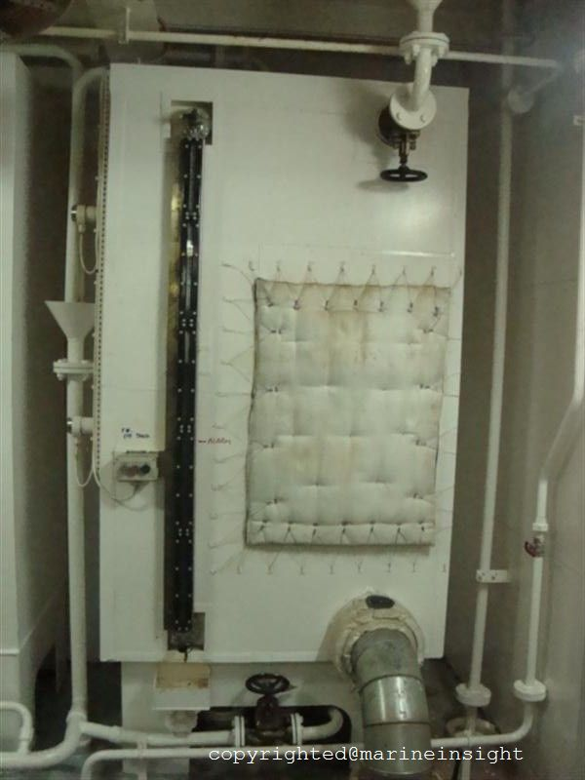
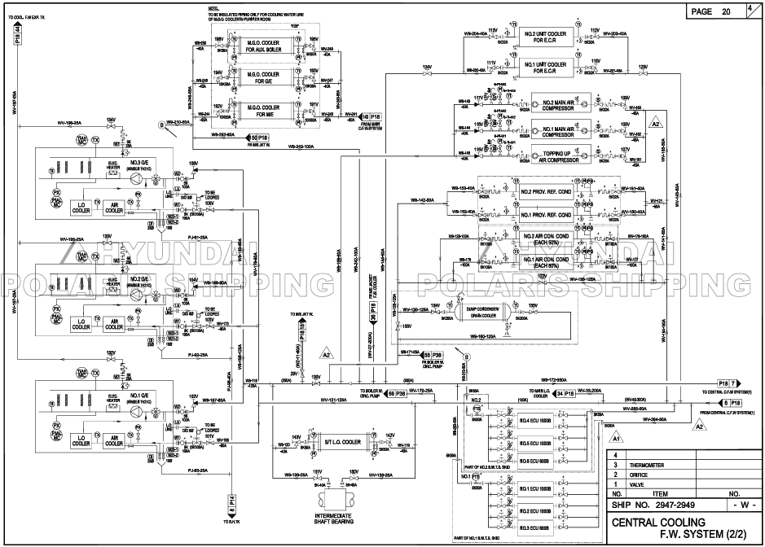
Cooling
fresh water expansion tank

Slide 4
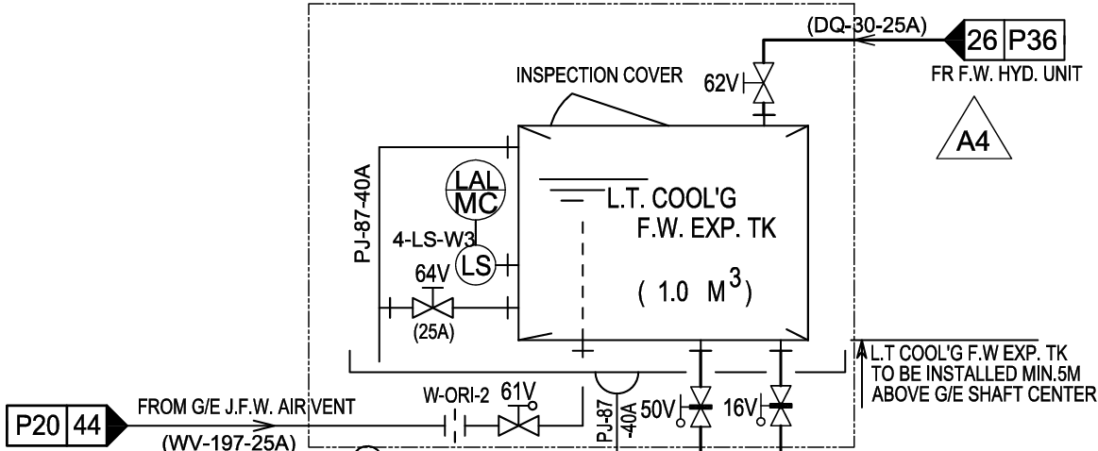
Cooling
fresh water expansion tank

Slide 5
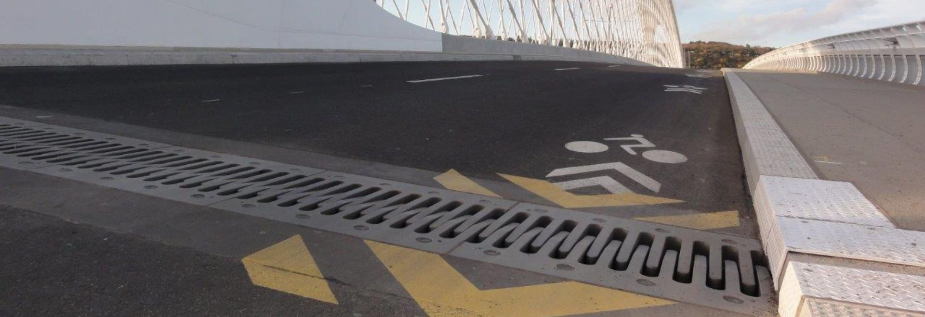
Cooling fresh water expansion tank
Cooling water storage and replenishment function
Stores cooling water (fresh water) used to cool the engine. It replenishes cooling water lost to evaporation, leakage, etc. during operation.
Provides space for cooling water expansion (acts as an expansion tank)
When the engine is running, the cooling water heats and expands. The cooling fresh water expansion tank receives this expanded cooling water, maintaining stable cooling system pressure.
Cooling water degassing
During operation, air (gas) bubbles may form in the cooling water. The tank provides a space for this gas to separate and escape, preventing cavitation and ensuring circulation stability.
Maintains circulation pressure
Since the cooling water system is a closed circulation system, the tank acts as a head tank, maintaining a constant water head. This ensures stable inlet pressure to the pump.
Cooling water quality control
Cooling fresh water expansion tanks typically have chemical inlets, allowing the addition of corrosion inhibitors or alkalinity regulators to prevent corrosion and scale.

Slide 6
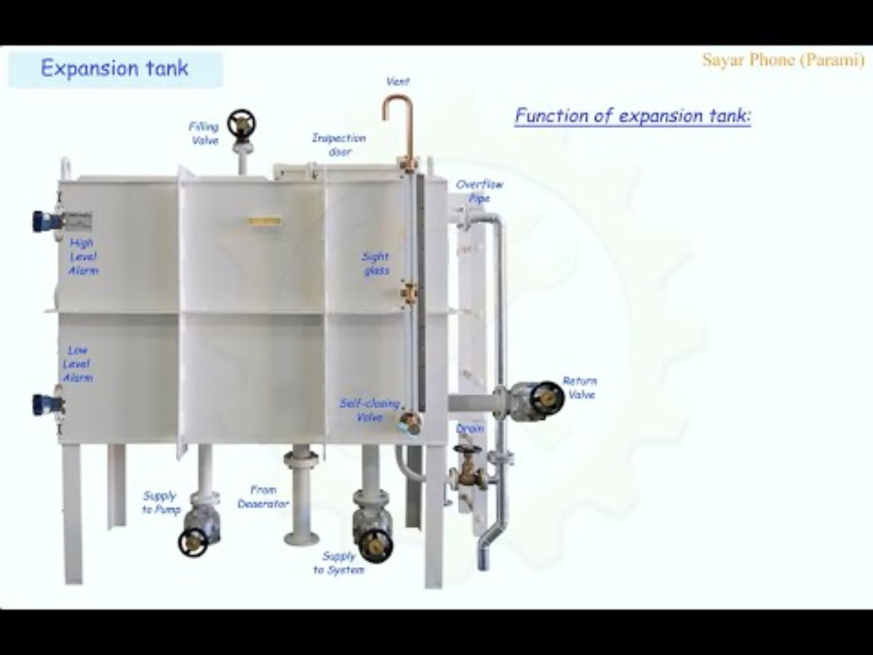
Cooling fresh water expansion tank

Slide 7

Cooling fresh water expansion tank

Slide 8
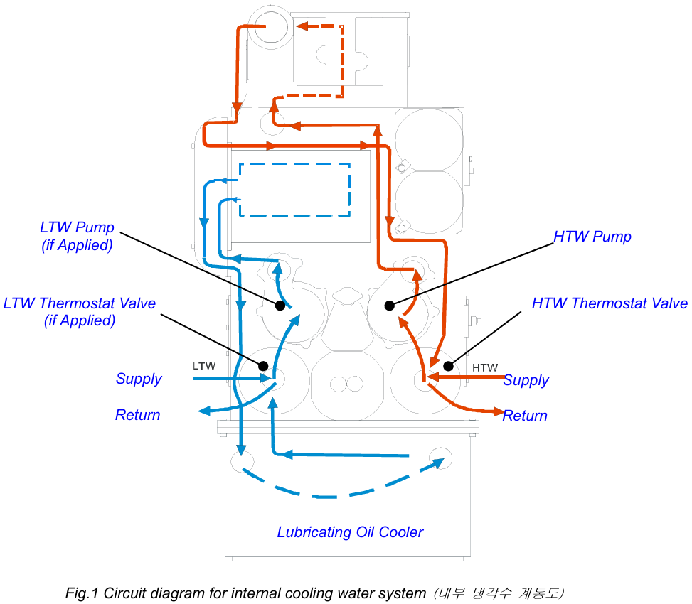
Cooling water system (HiMSEN)
The engine has two cooling water circuits internally, which are low temperature (LT) system and high temperature (HT) system. Most of the elements of the circuits are modularized and directly mounted on the feed block.
The cooling water system is designed for using normal fresh water with corrosion inhibitor. Both the low and the high temperature system are cooled by fresh water.

Slide 9
Cooling water system (HiMSEN)
The low temperature cooling water circulates by L.T pump and flows through charge air cooler and lubricating oil cooler internally.
L.T.W thermostat valve controls the water temperature by exchanging water with external circuit as shown in fig. 1.
The high temperature cooling water circulates by H.T pump internally and flows through cylinder head and water jacket (for cylinder liner) under normal operation. H.T.W thermostat valve controls the water temperature by exchanging water with external circuit.
charge air cooler

Slide 10
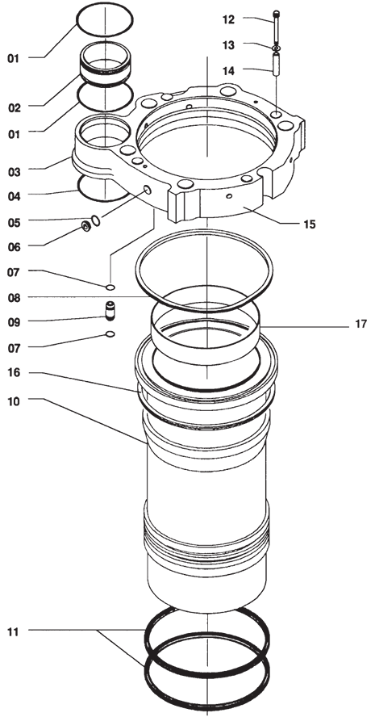
Hexagon screw
O-ring
Washer
Sleeve
Sleeve
O-ring
Water guide jacket
O-ring
Sealing ring
Plug screw
Water guide jacket
O-ring
Sealing ring
Cooling water connection
O-ring
Flame ring
Sealing ring
Cylinder liner
O-ring

Slide 11
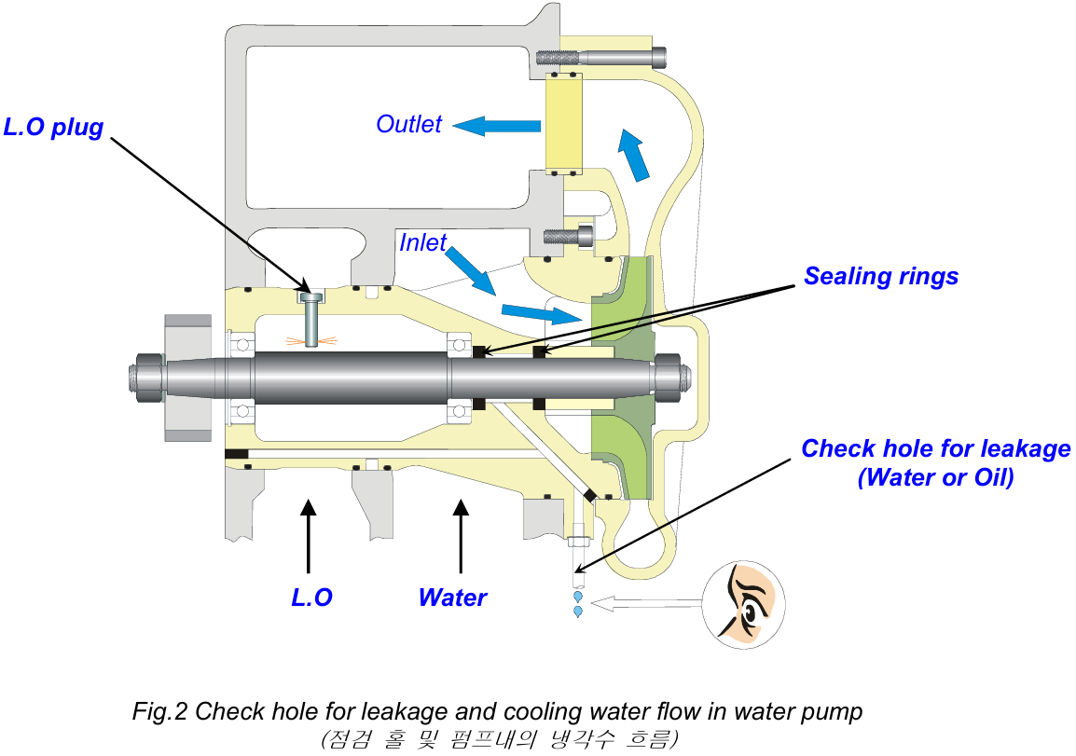
Cooling water system (HiMSEN)
The two cooling water pumps are of a centrifugal type and are driven by the gear wheel at the free end of the engine.
These two pumps are identical, but one is for circulating high temperature cooling water and the other is for low temperature cooling water.
Sealing rings are provided to avoid leakage between water side and oil side in the pump housing.

Slide 12
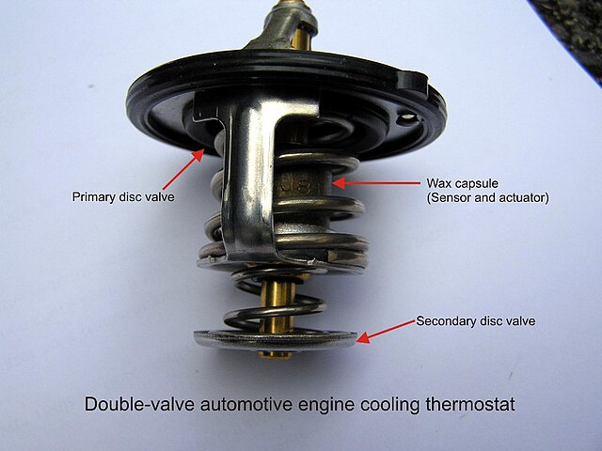
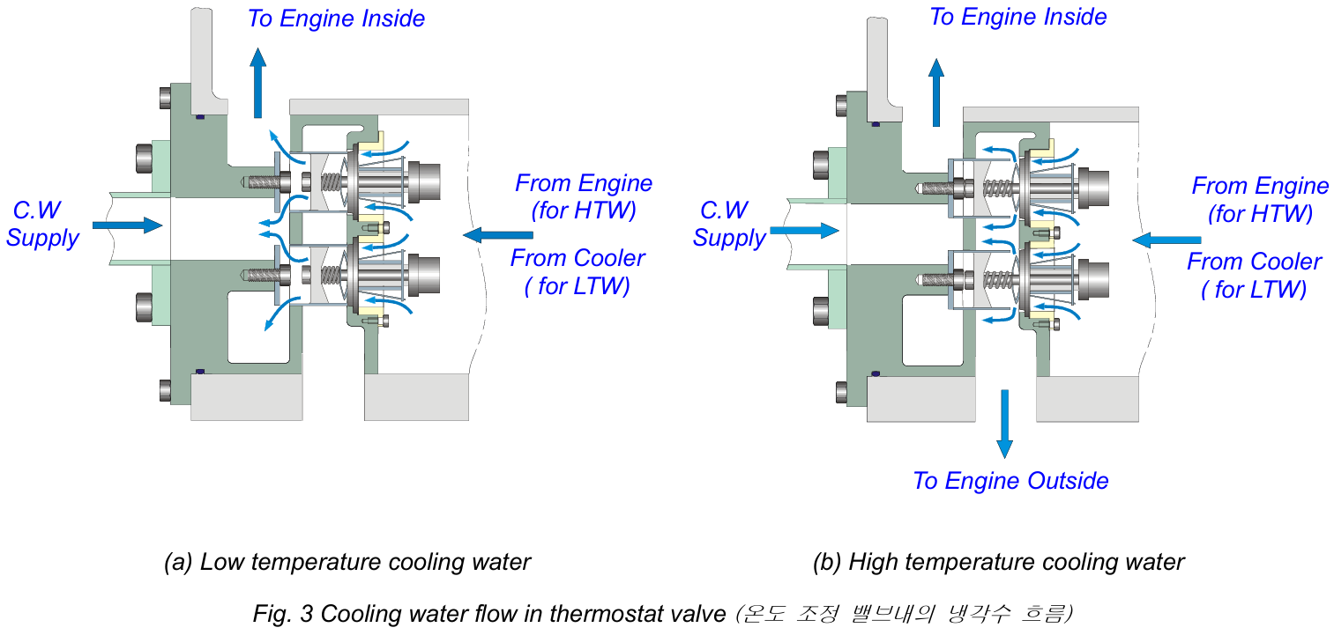
Cooling water system (HiMSEN)
The two thermostat valves for HT and LT water circuits respectively are mounted on the feed block of the engine.
They are of the wax element type and cannot be adjusted. The thermostat valve controls the flow direction of the cooling water depending on the water temperature in the engine block appropriately as shown in fig. 3.

Slide 13
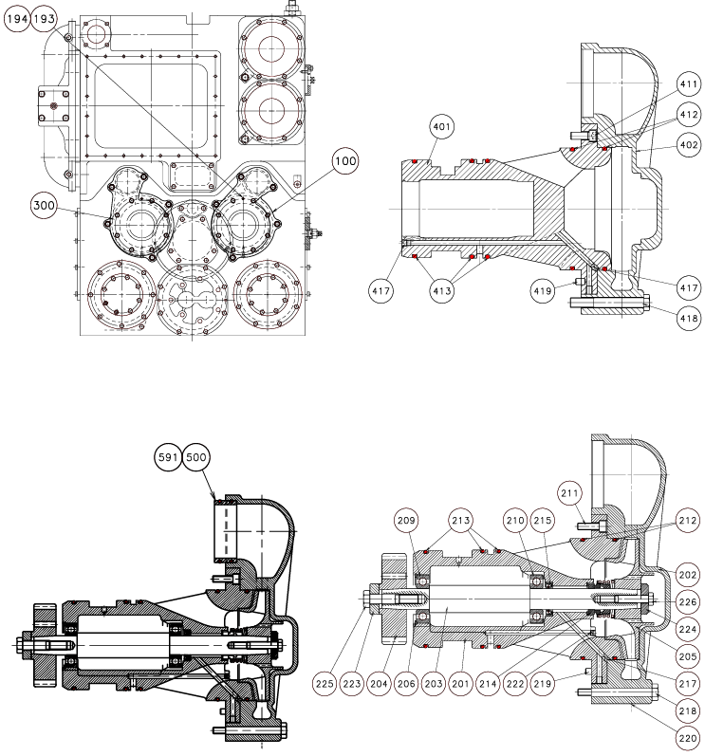
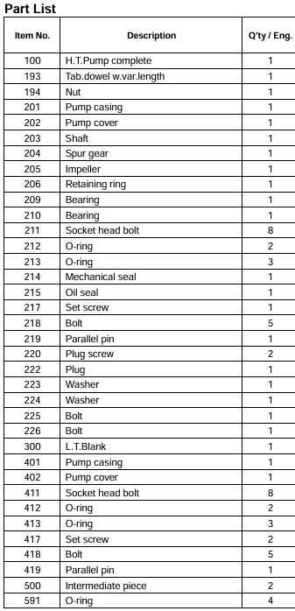

Slide 14
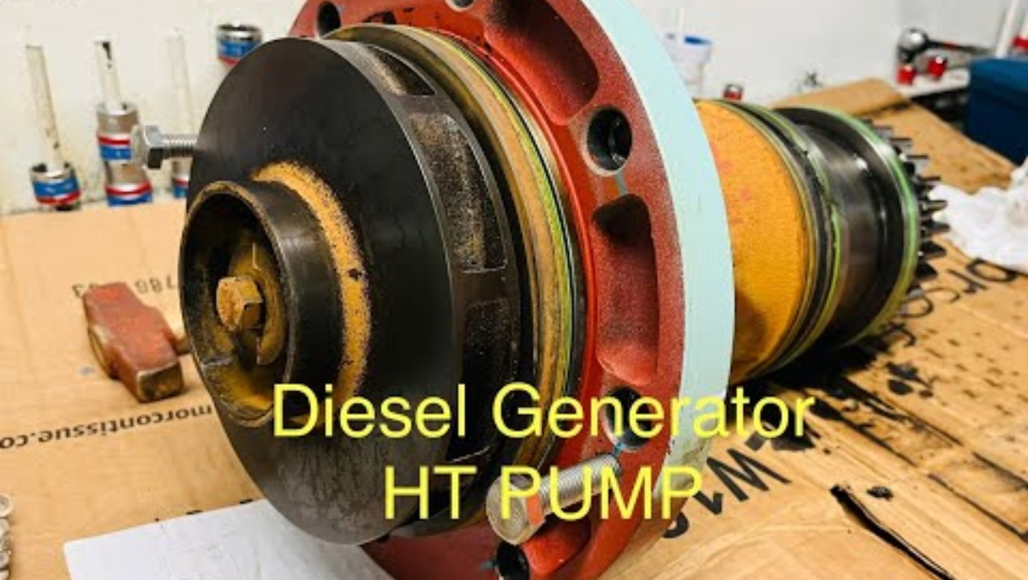
Cooling water system (HiMSEN)

Slide 15
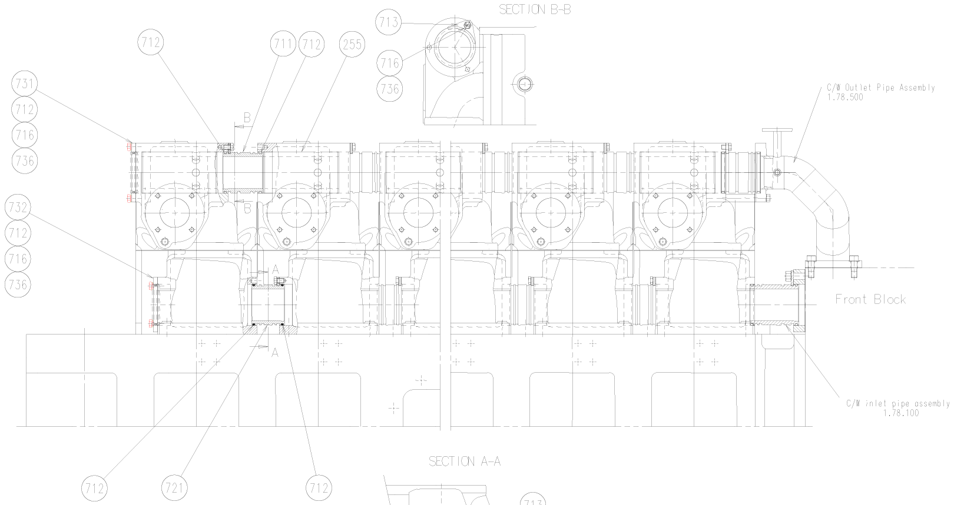

Cooling water system (HiMSEN)
Cooling water outlet pipe assembly
Cooling water inlet pipe assembly

Slide 16
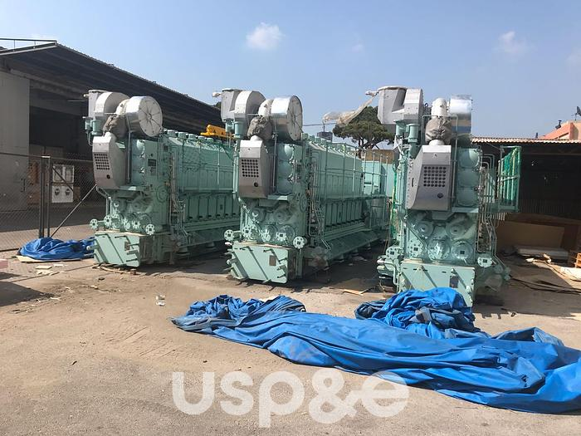
Cooling water system (HiMSEN)
L.O. cooler

Slide 17
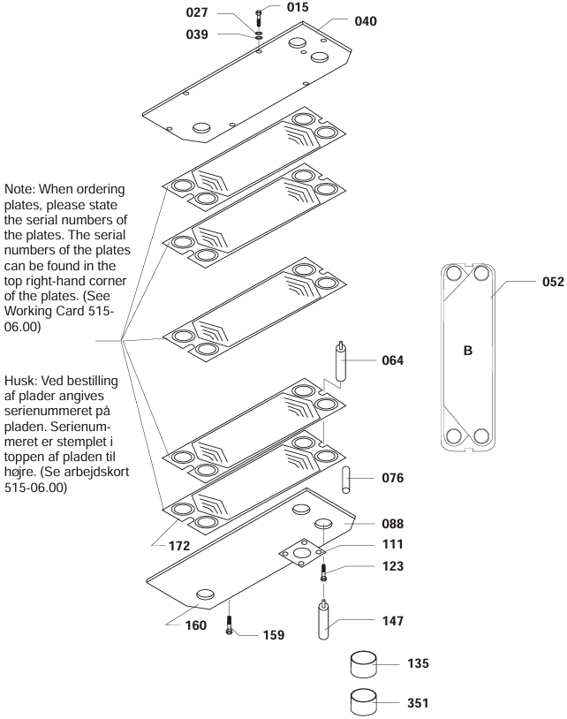
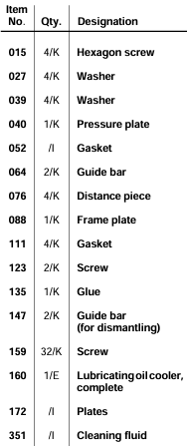
L.O. cooler

Slide 18
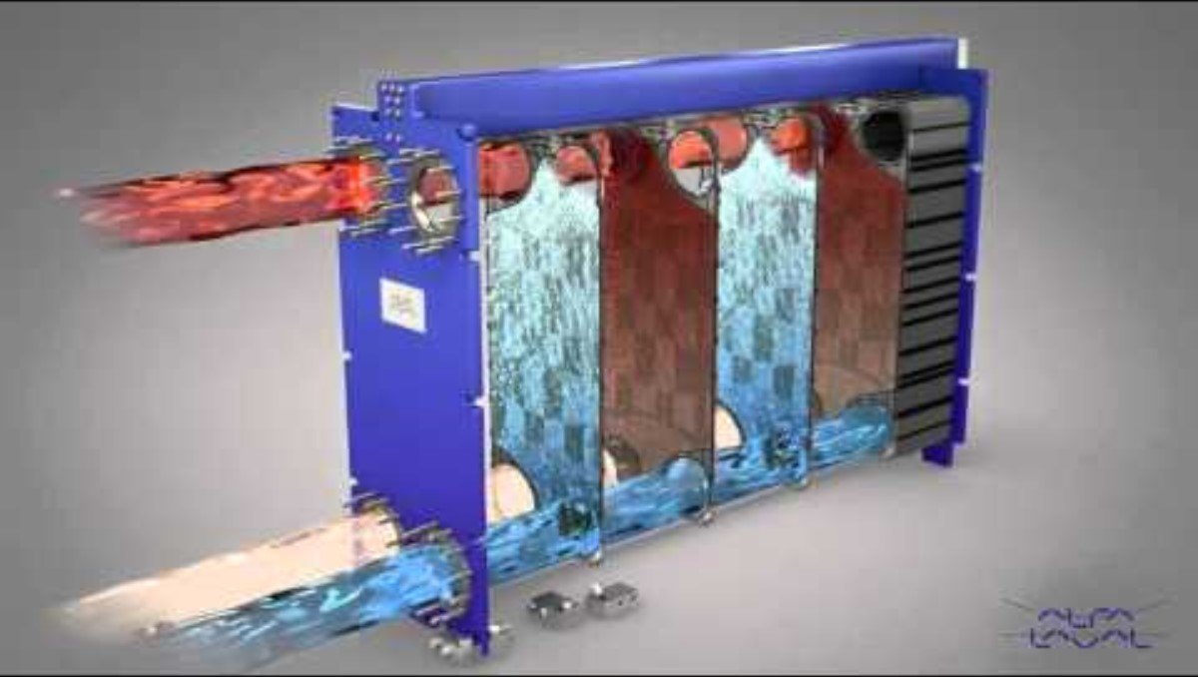
Plate type heat exchanger (=Cooler)

Slide 19
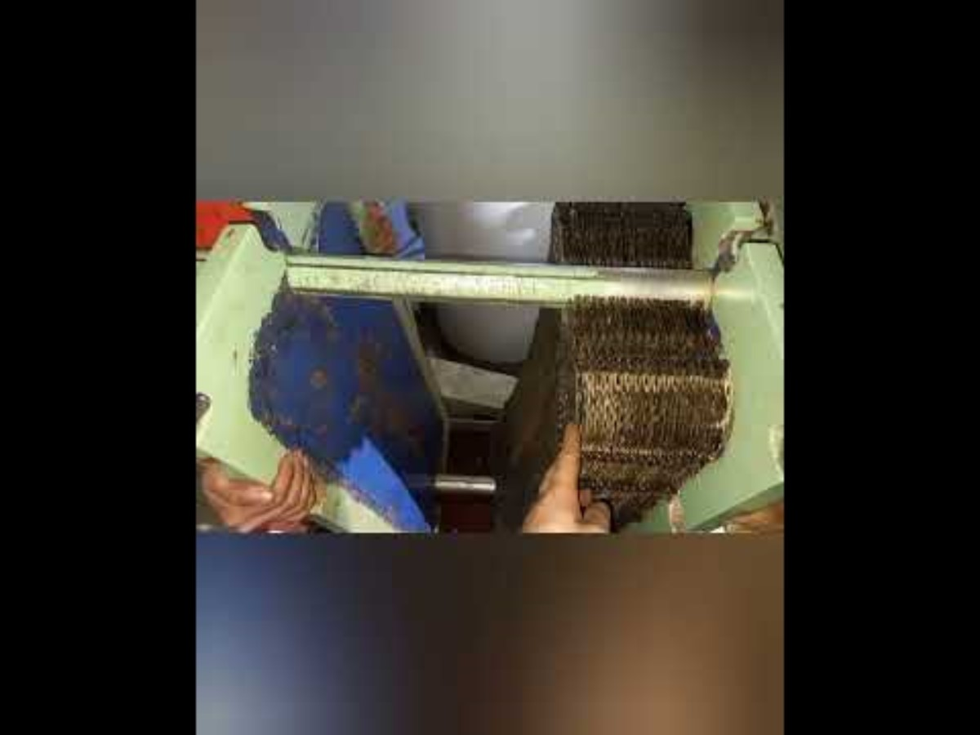
Plate type heat exchanger (=Cooler)

Slide 20
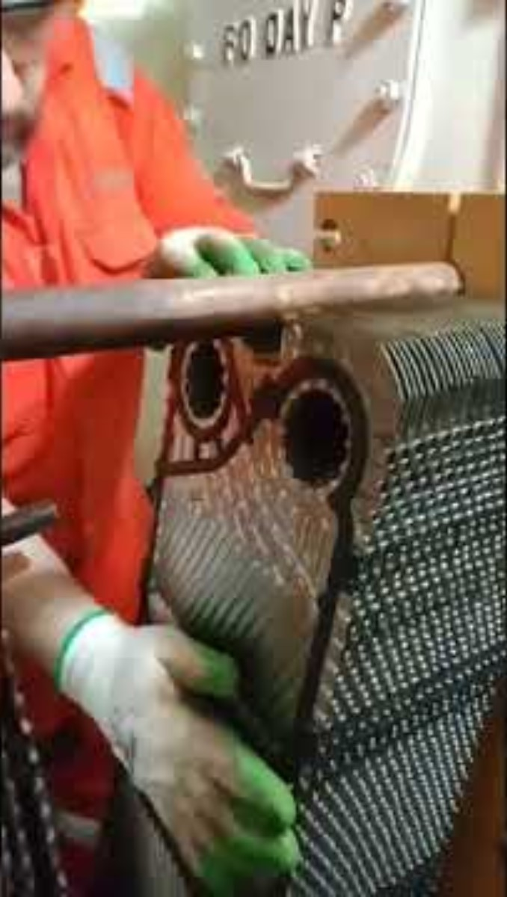
Plate type heat exchanger (=Cooler)

Slide 21

Plate type heat exchanger (=Cooler)

Slide 22

Plate type heat exchanger (=Cooler)

Slide 23
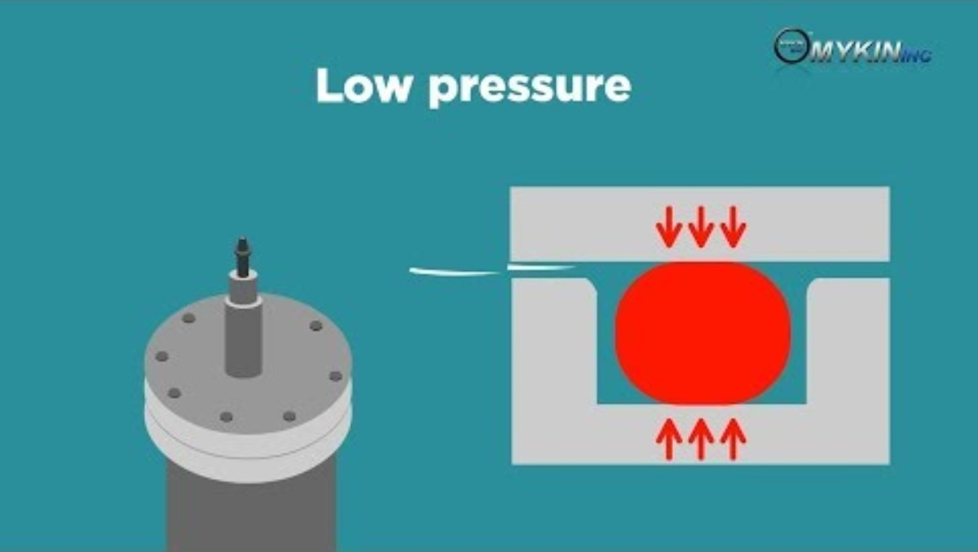
Plate type heat exchanger (=Cooler)

Slide 24
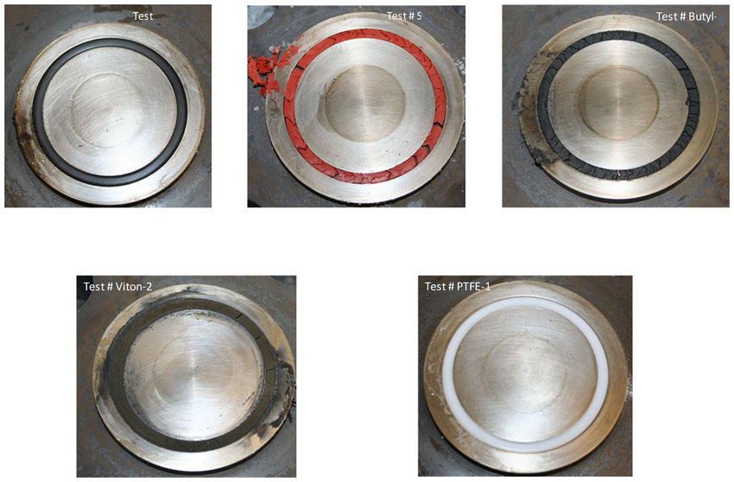
Plate type heat exchanger (=Cooler)
In plate type heat exchangers, a rubber gasket is used to separate the two fluid flows.
However, rubber gaskets harden when exposed to heat for a long period of time, becoming less elastic and thus hindering the separation of the two fluids.
In particular, when the plate inside the plate type heat exchanger is disassembled for cleaning, the elasticity and damage of the gasket should be checked, and any problematic gaskets should be replaced with spare gaskets.

Slide 25
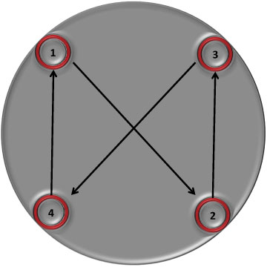
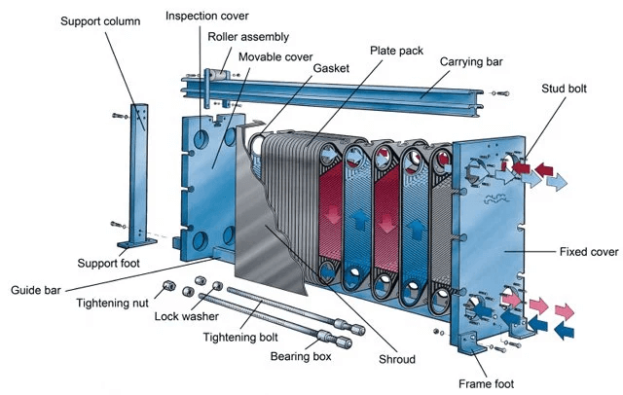
Plate type heat exchanger (=Cooler)
After cleaning the plate, when assembling the plate exchanger, tighten the tightening nut in an X shape to ensure that the rubber gasket is evenly sealed throughout.
If you tighten one nut as tight as possible and then tighten the other nut as tight as possible, the rubber gasket will not seal evenly, causing leakage.

Slide 26
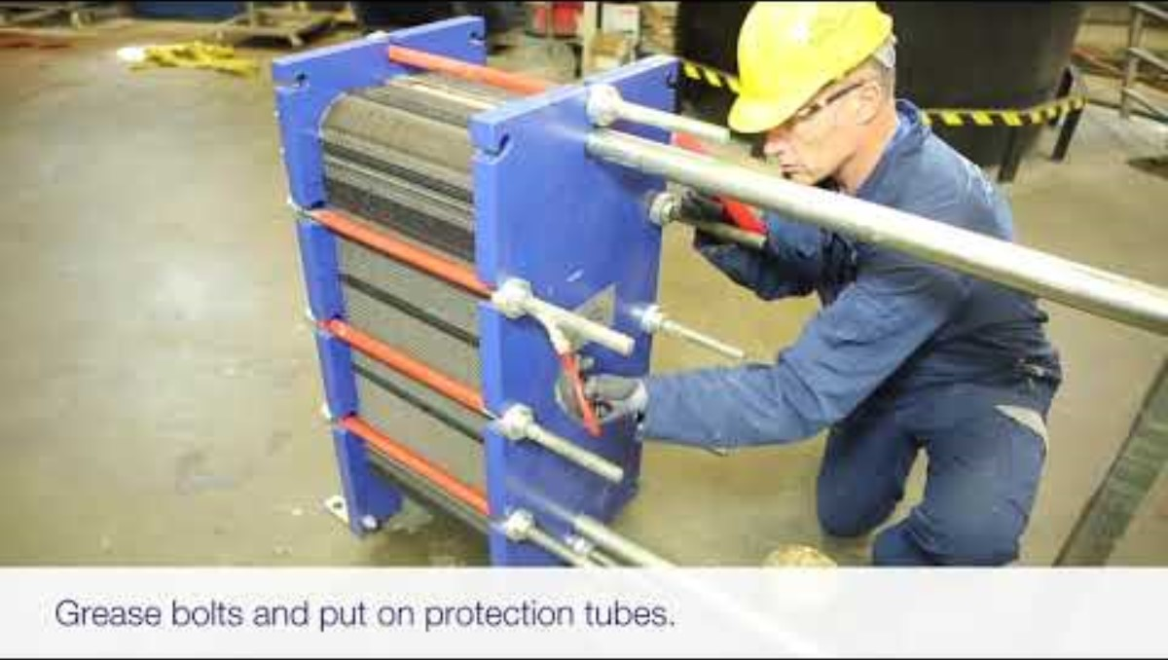
Plate type heat exchanger (=Cooler)

Slide 27
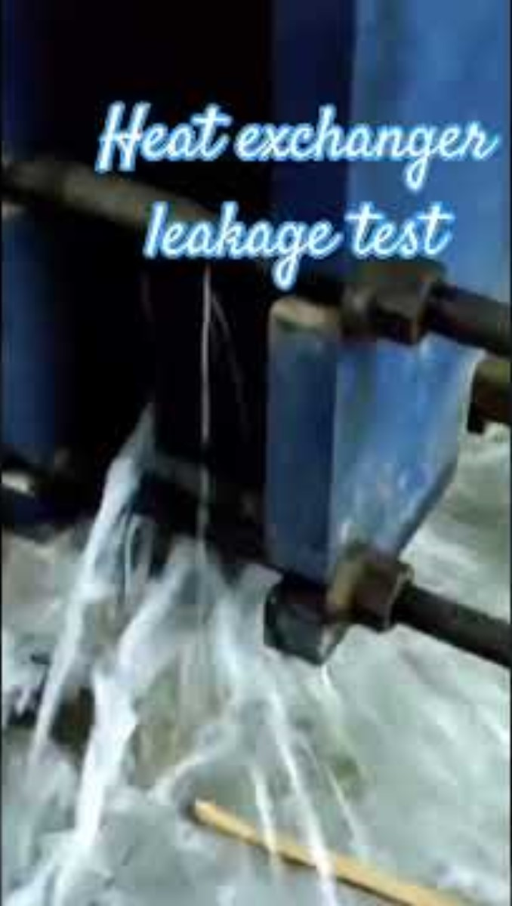
Plate type heat exchanger (=Cooler)

Slide 28
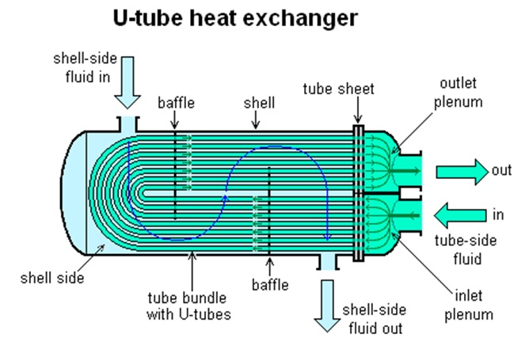
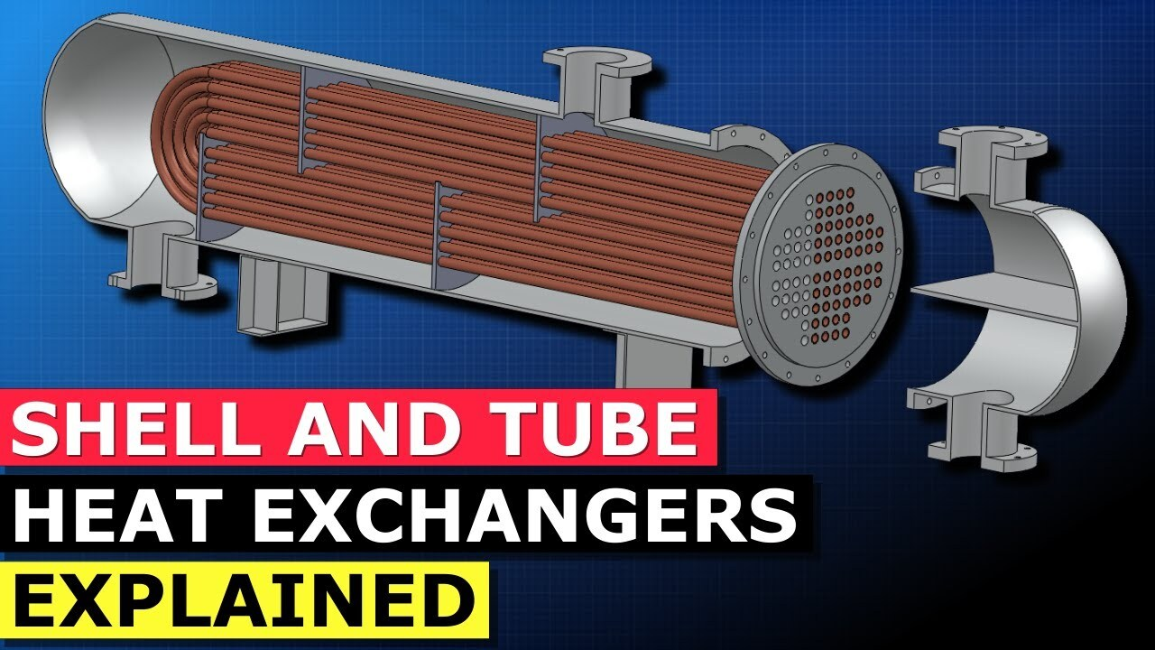
Shell type heat exchanger (=Cooler)
The L.O. cooler of some generators uses a shell type heat exchanger.

Slide 29
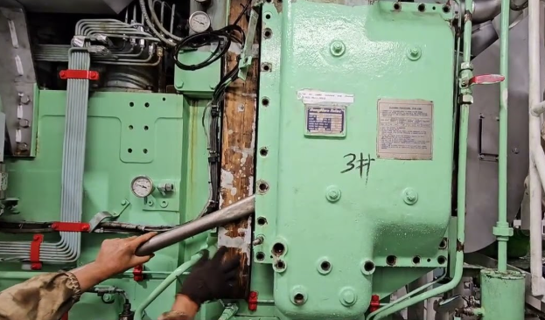
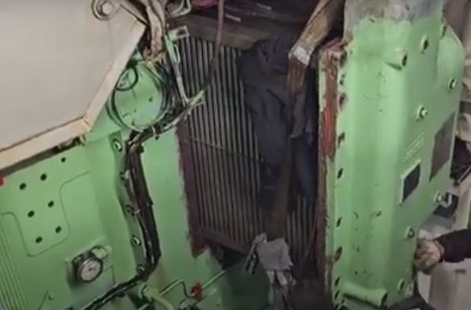
Air Cooler (HiMSEN)
Charge air cooler

Slide 30
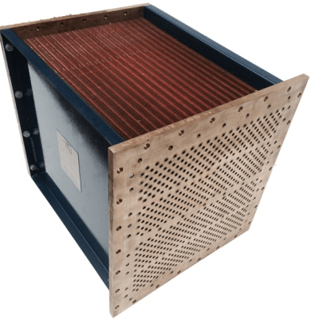
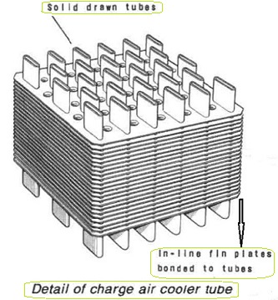
Air Cooler (HiMSEN)
Charged air
Cooling water flows through the tubes and charged air from the turbocharger flows between the fins.
Accordingly, heat exchange occurs between the cooling water and the charged air, so that the charged air is cooled and supplied into the cylinder.
Cooling water

Slide 31
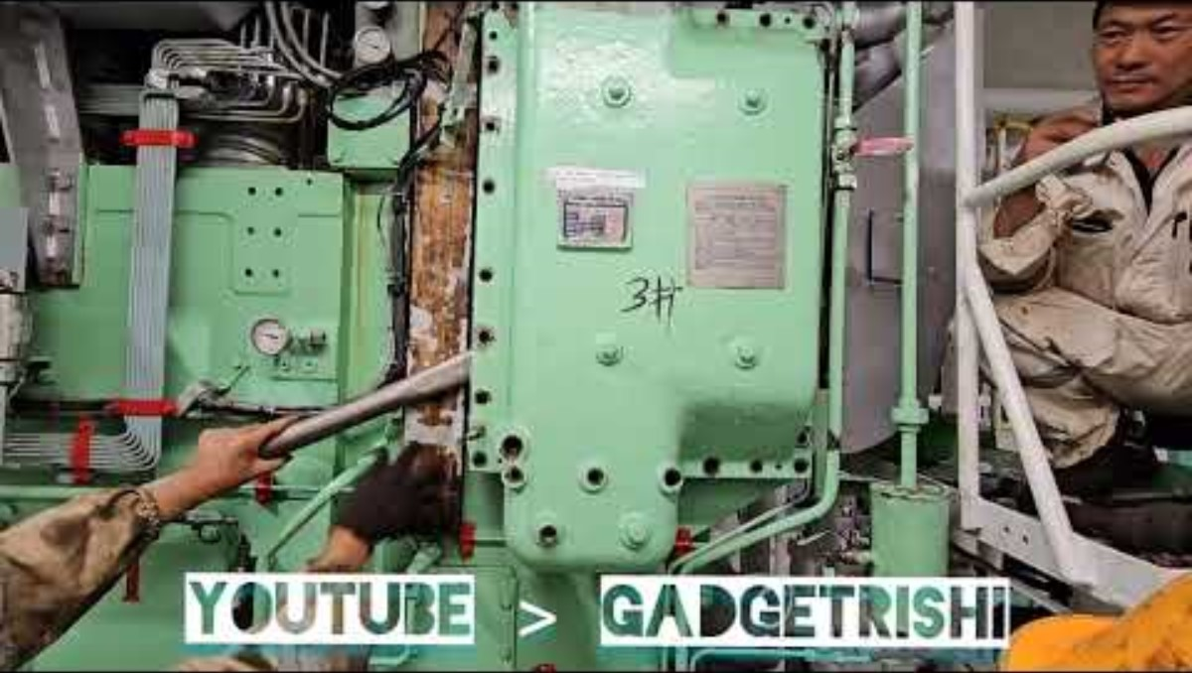
Air Cooler (HiMSEN)

Slide 32
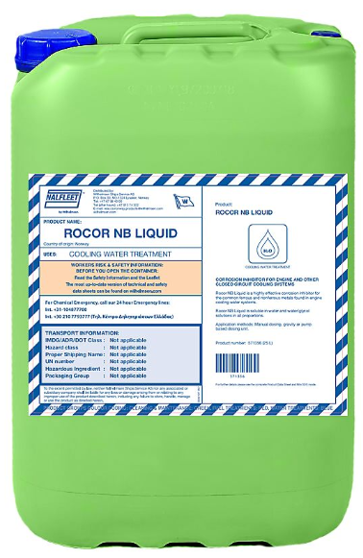
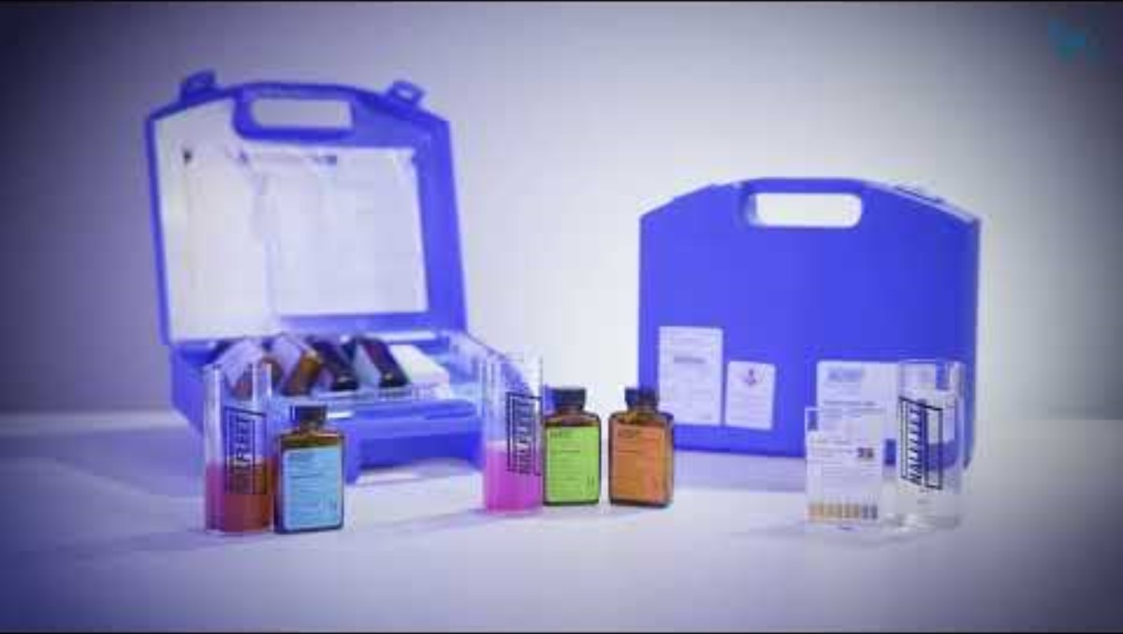
Cooling water treatment test
A cooling water treatment test is conducted to determine the current condition of the G/E's cooling water.
Based on the test results, chemicals are added to the cooling fresh water expansion tank to prevent corrosion and suppress scale caused by cooling water.
1) Nitrite test, 2) Chloride test, 3) pH test
Notes:
Nitrite: 아질산염
Chloride: 염화물

Slide 33
References
1) https://www.thermomegatech.com/products/
2) https://www.youtube.com/watch?v=nJEF5uO9o2g
3) https://www.youtube.com/watch?v=r-8vv3dQ1oc
4) https://www.youtube.com/watch?v=uEInVVcc6Sc
5) https://www.youtube.com/watch?v=_2xPxMPZV6I
6) https://www.youtube.com/watch?v=s5nJG0om8KY
7) https://www.sciencedirect.com/science/article/pii/S0142941816311643?via%3Dihub
8) https://www.alfalaval.my/products/heat-transfer/plate-heat-exchangers/gasketed-plate-and-frame-heat-exchangers/heat-exchanger/how-plate-heat-exchanger-work/

Slide 34
References
9) https://nlmotoring.com/wheel-academy/how-to-tighten-lug-nuts/?srsltid=AfmBOooBJojGDbeolgqsz7mvjOOXO_OW6vSWCtFHcM_JrrFQFYmnjEUC
10) https://www.youtube.com/watch?v=Atz2XwcjZ48
11) https://www.youtube.com/shorts/2qQGLiCL4vo
12) http://generalcargoship.com/charged-air-cooler.html
13) https://muckymariners.com/app/meo-class-4-subjects/function-4b-meol/auxiliary-machines/11-heat-exchanger/heat-exchanger-2-5-types/
14) https://www.vrcoolertech.com/news/5-types-of-shell-and-tube-heat-exchangers-and-78264382.html
15) https://www.justdial.com/jdmart/Bangalore/Stainless-Steel-Heat-Exchanger-Suitable-for-Industrial-Applications-Flow-Rate-1200-Nm3hr-Maximum-Working-Pressure-10-bar/pid-2031869768/080PXX80-XX80-110315174638-U3S5

Slide 35
References
16) https://www.youtube.com/watch?v=CNry-CKNkeM
17) https://www.wilhelmsen.com/product-catalogue/products/marine-chemicals/water-treatment-chemicals/cooling-water-treatment/
18) https://www.freyssinet.com/solution/build/expansion-joints/expansion-joints-road/

